Slide 1


E-commerce 2023–2024: business. technology. society.
Eighteenth Edition
Chapter 3
E-commerce Infrastructure
Internet
© 2023 Pearson Education Ltd. All Rights Reserved
Notes:
If this PowerPoint presentation contains mathematical equations, you may need to check that your computer has the following installed:
1) MathType Plugin
2) Math Player (free versions available)
3) NVDA Reader (free versions available)
Slides in this presentation contain hyperlinks. JAWS users should be able to get a list of links by using INSERT+F7

Slide 2
Learning Objectives
3.1 Discuss the origins of, and the key technology concepts behind, the Internet.
3.2 Explain the current structure of the Internet.
3.3 Understand how the Web works.
3.4 Describe how Internet and web features and services support e-commerce.
3.5 Understand the impact of mobile applications.

Slide 3
The Internet Survives the Covid-19 Pandemic: Why It Didn’t Break
Class Discussion
How has your usage of the Internet changed as a result of the pandemic?
Why were fears that the Internet would break misguided?
How has the pandemic highlighted the issues raised by the “digital divide”?

Slide 4
The Internet: Technology Background
Internet
Interconnected network of thousands of networks and millions of computers
Links businesses, educational institutions, government agencies, and individuals
World Wide Web (Web)
One of the Internet’s most popular services
Provides access to billions, possibly trillions, of web pages

Slide 5
The Evolution of the Internet 1961–Present
Innovation Phase, 1961–1974
Creation of fundamental building blocks
Institutionalization Phase, 1975–1995
Large institutions provide funding and legitimization
Commercialization Phase, 1995–present
Private corporations take over, expand Internet backbone and local service

Slide 6
The Internet: Key Technology Concepts
Internet defined as network that:
Uses I P addressing
Supports T C P/I P
Provides services to users, in manner similar to telephone system
Three important concepts:
Packet switching
T C P/I P communications protocol
Client/server computing

Slide 7
Packet Switching
Slices digital messages into packets
Sends packets along different communication paths as they become available
Reassembles packets once they arrive at destination
Uses routers
Less expensive, wasteful than circuit-switching

Slide 8
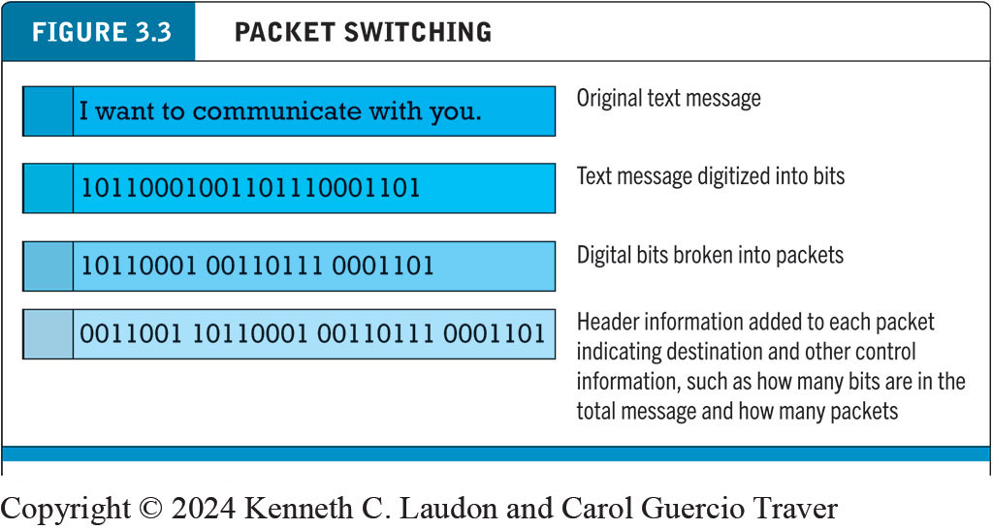
Figure 3.3 Packet Switching
Notes:
Figure 3.3, Page 116.
In packet switching, digital messages are divided into fixed-length packets of bits (generally about 1,500 bytes). Header information indicates both the origin and the ultimate destination address of the packet, the size of the message, and the number of packets the receiving node should expect. Because the receipt of each packet is acknowledged by the receiving computer, for a considerable amount of time, the network is not passing information, only acknowledgments, producing a delay called latency.
Alt Text
Long description: The illustration explains how packet switching works. The original text message reads, I want to communicate with you. The text message is digitized into bits, or a series of 1’s and 0’s, as follows 1 0 1 1 0 0 0 1 0 0 1 1 0 1 1 1 0 0 0 1 1 0 1. Digital bits are broken into packets of 7 or 8 1’s and 0’s, as follows: the first packet contains the following digital bits: 1 0 1 1 0 0 0 1; the second packet contains the following digital bits: 0 0 1 1 0 1 1 1; the third packet contains the following digital bits: 0 0 0 1 1 0 1. Header information is added to each packet indicating destination and other control information, such as how many bits are in the total message and how many packets, as follows: the first packet contains the following digital bits: 0 0 1 1 0 0 1; the second packet contains the following digital bits: 1 0 1 1 0 0 0 1; the third packet contains the following digital bits: 0 0 1 1 0 1 1 1; the fourth packet contains the following digital bits: 0 0 0 1 1 0 1

Slide 9
T C P/I P Protocol Suite (1 of 2)
Large family of protocols named after its most important members: TCP and IP
Transmission Control Protocol (T C P)
Establishes connections among sending and receiving Web computers; handles assembly of packets at point of transmission, and reassembly at receiving end
Internet Protocol (I P)
Provides addressing scheme; responsible for delivery of packets
Uniform Data Protocol (UDP)
Provides alternative to TCP when error-checking, correction functionality not necessary

Slide 10
T C P/I P Protocol Suite (2 of 2)
Four T C P/I P layers
Network interface layer:
Places packets on and receives them from network medium
Internet layer
Addresses, packages, and routes messages
Transport layer
Communication with other protocols in TCP/IP suite
TCP, UDP, and QUIC
Application layer
Protocols used to provide user services or exchange data
BGP, HTTP, FTP, SMTP, etc.

Slide 11
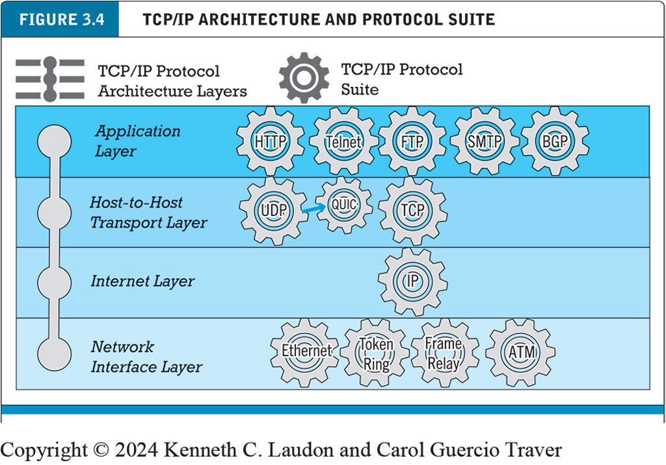
Figure 3.4 The T C P/I P Architecture and Protocol Suite
Notes:
Figure 3.4, Page 118.
TCP/IP is an industry-standard suite of protocols for large internetworks. The purpose of TCP/IP is to provide high-speed communication network links.
Alt Text
Long description: An illustration depicts the T C P and I P protocol architecture layers and the related elements of the T C P and I P protocol suite., as follows: From the bottom up, Network Interface layer: Ethernet, token ring, frame relay, and A T M; Internet Layer: I P; Host to host transport layer, U D P, QUIC, and T C P; Application layer: H T T P, Telnet, F T P, S M T P, and B G P.

Slide 12
Internet (I P) Addresses
I P v4
32-bit number
Four sets of numbers marked off by periods: 201.61.186.227
I P v6
128-bit addresses, able to handle up to 1 quadrillion addresses (I P v4 can handle only 4 billion)

Slide 13
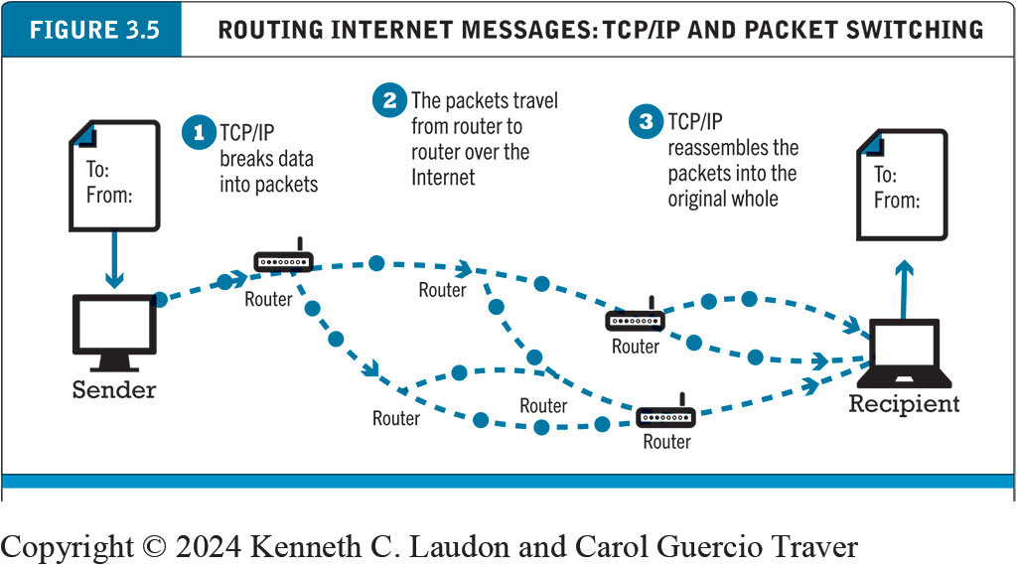
Figure 3.5 Routing Internet Messages: T C P/I P and Packet Switching
Notes:
Figure 3.5, Page 118.
The Internet uses packet-switched networks and the TCP/IP communications protocol to send, route, and assemble messages. Messages are broken into packets, and packets from the same message can travel along different routes.
Alt Text
Long description: A message is sent from the sender. Step 1, T C P, I P breaks the data into packets. Step 2, the packets travel from router to router over the Internet. Step 3, T C P, I P reassembles the packets into the original whole. The message arrives at the receiver.

Slide 14
Domain Names, DNS, and Uniform Resource Locators
Domain name
IP address expressed in natural language
Domain name system
Allows numeric IP addresses to be expressed in natural language
Uniform resource locator (URL)
Address used by web browser to identify location of content on the Web
Example: www.google.com

Slide 15
Client/Server Computing
Model of computing in which client devices are connected in a network together with one or more servers
Clients: various types of devices that can request access to services or resources
Servers perform common functions for the clients
Storing files
Software applications
Access to printers
Internet access
Internet is example of client/server computing on massive scale

Slide 16
The Mobile Platform
Primary Internet access is now through smartphones and tablets
Smartphones
Examples: Apple iPhone, Samsung Galaxy
Around 260 million in U.S. access Internet with mobile phone
Tablets
Examples: Apple iPad, Microsoft Surface
About 170 million in U . S. access Internet with tablets

Slide 17
The Internet “Cloud Computing” Model (1 of 2)
Model of computing in which computing processing, storage, software, and other services are provided as a shared pool of virtualized resources via the Internet
Three primary types of services
Infrastructure as a service (I a a S)
Software as a service (S a a S)
Platform as a service (P a a S)
Public, private, and hybrid clouds

Slide 18
The Internet “Cloud Computing” Model (2 of 2)
Drawbacks
Shifts responsibility for storage and control to providers
Security risks
Can introduce latency (delays in processing and transmitting of data
Implications for e-commerce
Radically reduces costs of:
Building and operating websites
Infrastructure, I T support
Hardware, software

Slide 19
Other Internet Protocols
HTTP
HTTP/2; HTTP/3
Email
SMTP
POP3
IMAP
FTP
Superseded by FTPS, SFTP
SSL/TLS

Slide 20
Internet Infrastructure
Internet has been able to grow exponentially without disruption because of:
Client/server computing model
Architecture built in layers that can be changed independently
Layers
Network Technology Substrate
Transport Services and Representation Standards
Middleware Services
Applications

Slide 21
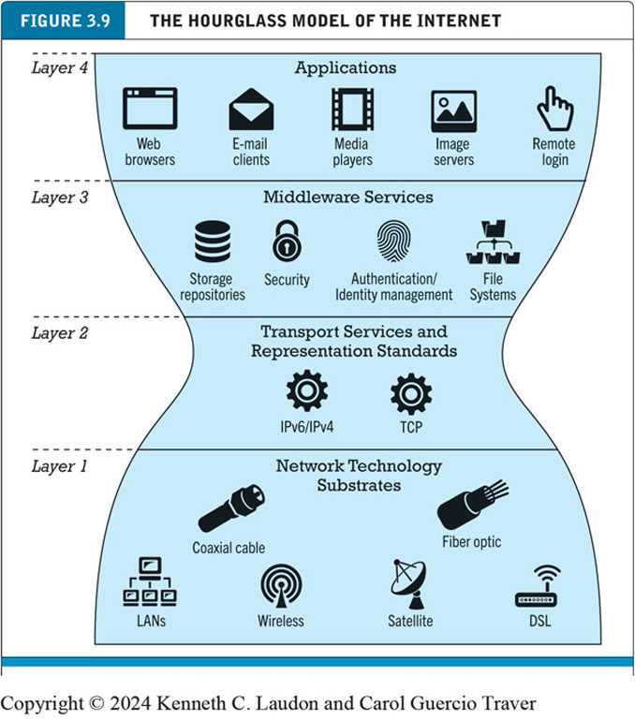
Figure 3.9 The Hourglass Model of the Internet
Notes:
Figure 3.10 Page 127.
The Internet can be characterized as an hourglass modular structure with a lower layer containing the bit-carrying infrastructure (including cables and switches) and an upper layer containing user applications such as e-mail and the Web. In the narrow waist are transportation protocols such as TCP/IP.
Alt Text
Long description: The hourglass model depicts the internet as being divided into 4 layers, in an hourglass shape, from bottom to top, as follows. Layer 1 at the wide bottom of the hourglass: Network technology substrates including coaxial cable, LANs, wireless, satellite, fiber optic, and D S L. Layer 2, at the narrowest part of the hourglass: Transport services and representation standards including I P v 6, I P v 4, and T C P. Layer 3 at the widening middle of the hourglass: middleware services including storage repositories, security, authentication and identity management, and file systems. Layer 4, at the top and widest part of the hourglass: applications including web browsers, email clients, media players, image servers, and remote login.

Slide 22
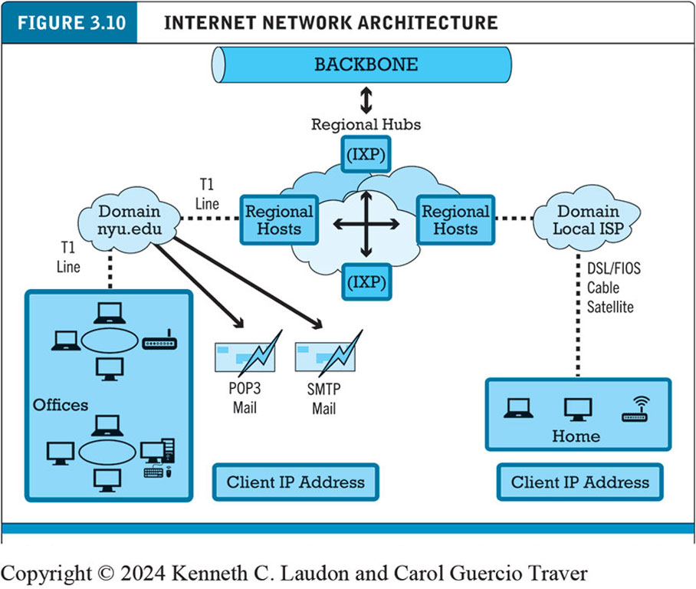
Figure 3.10 Internet Network Architecture
Notes:
Figure 3.10, Page 128.
Today’s Internet has a multi-tiered open network architecture featuring multiple backbones, regional hubs, campus/corporate area networks, and local client computers.
Alt Text
Long description: The backbone exchanges information with regional hubs, which include I X P’s and regionals hosts. The I X P’s and regional hosts exchange information with one another. Regional hosts are connected to a domain local I S P and via a T 1 line to the domain N Y U dot e d u. The domain local I S P is connected via D S L, FIOS, cable, or satellite to a home computer with a client I P address. The domain N Y U dot e d u is connected via a T1 line to networks in offices with a client I P address. The domain N Y U dot e d u is also connected to POP 3 Mail and S M T P mail protocols.

Slide 23
The Internet Backbone
Comprised of fiber-optic cable: hundreds of glass strands that use light to transmit data
Faster speeds and greater bandwidth
Thinner, lighter cables
Less interference
Better data security
Tier 1 Internet Service Providers (Tier 1 I S P s) or transit I S P s
Numerous private networks physically connected to each other
Undersea fiber optics, satellite links

Slide 24
Internet Exchange Points (I X P s)
Regional hubs where Tier 1 I S P s physically connect with one another and with regional Tier 2 I S P s.
Tier 2 I S P s provide Tier 3 I S P s with Internet access.
Originally called Network Access Points (N A P s) or Metropolitan Area Exchanges (M A E s).

Slide 25
Tier 3 Internet Service Providers
Retail providers
Lease Internet access to homeowners, small businesses
Large providers: Comcast, Charter Spectrum, A T&T, Verizon, Altice (Optimum)
Smaller local providers
Services
Narrowband
Broadband
Digital subscriber line (D S L)
Cable Internet
Satellite Internet: GEO and LEO

Slide 26
Insight on Technology: The Internet Space Race
Class discussion
Have you ever used traditional satellite Internet, such as that offered by Dish, HughesNet, or Viasat?
If so, what was the experience like? How did it differ from other types of Internet access?
Have you used LEO satellite Internet, such as Starlink?
If so, what was the experience like? How did it differ from other types of Internet access?
Do you think LEO satellite Internet will help reduce the “digital divide”? Why or why not?

Slide 27
Mobile Internet Access
Emergence of mobile Internet access one of the most significant developments for Internet and Web
Concerned with the last mile of Internet access to user’s home, office, car, smartphone or tablet computer
280 million mobile Internet users in U.S. (83% of population
Two basic types:
Telephone-based (mobile phones, smartphones)
Computer network-based (wireless local area network-based)

Slide 28
Telephone-based Wireless Internet Access
Connects user to global telephone system (land, satellite, and microwave)
4G: true broadband access, speeds up to 100 Mbps
5G: very high-bandwidth broadband; speeds reaching 10 Gbps or more
Uses new part of wireless spectrum and tens of thousands of small-cell and distributed antenna systems
Expected to enable many innovative products. services

Slide 29
Wireless Local Area Network (W L A N) -Based Internet Access
Wi-Fi: various 802.11 standards, also known as Wi-Fi 4, Wi-Fi 5, and Wi-Fi 6
High-speed, fixed broadband wireless L A N (W L A N)
Wireless access points (“hot spots”)
Limited range but inexpensive
WiMax: 802.16 standard; used for medium-range, broadband wireless metropolitan area networks
Bluetooth: technology standard for short-range wireless communication within a 30-foot distance

Slide 30
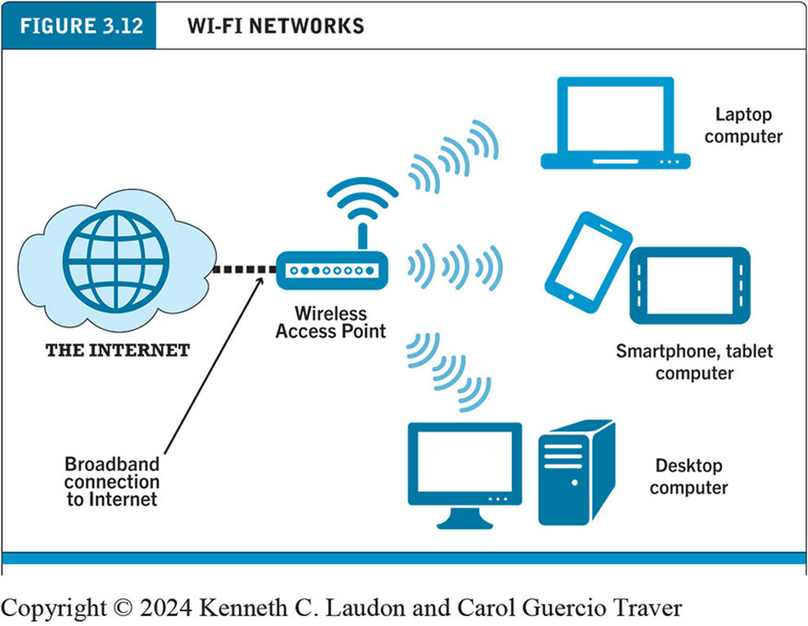
Figure 3.12 Wi-Fi Networks
Notes:
Figure 3.12, page 138.
In a Wi-Fi network, wireless access points connect to the Internet using a land-based broadband connection. Clients, which could be desktops, laptops, tablet computers, or smartphones, connect to the access point using radio signals.
Alt Text
Long description: A wireless access point is connected to the internet by a broadband connection. The access point provides internet access to devices such as a laptop and desktop computer and a smartphone or tablet computer.

Slide 31
The Internet of Things (I O T)
Objects connected via sensors/R F I D to the Internet
Being enabled by:
Availability of low-cost sensors
Drop in price of data storage
Development of big data analytics software
Implementation of IPv6
Powering development of “smart” connected things
Interoperability issues and standards
Security and privacy concerns

Slide 32
Who Governs the Internet?
Organizations that influence the Internet and monitor its operations include:
Internet Corporation for Assigned Names and Numbers (I C A N N)
Internet Engineering Task Force (I E T F)
Internet Research Task Force (I R T F)
Internet Engineering Steering Group (I E S G)
Internet Architecture Board (I A B)
Internet Society (I S O C)
Internet Governance Forum (I G F)
World Wide Web Consortium (W3C)
Internet Network Operators Groups (N O G s)

Slide 33
Insight on Society: Government Regulation and Surveillance of the Internet
Class discussion:
How is it possible for any government to “control” or censor the Web?
Do governments have the right to censor online content?
How should companies deal with governments that want to censor content?
What would happen to e-commerce if the existing Web split into a different Web for each country?

